Slide 1
1. Analyze the following quote by Thomas Jefferson.
2. Please complete a written response that describes your thoughts regarding the quote.
“Whenever any form of government becomes destructive of these ends [life, liberty, and the pursuit of happiness] it is the right of the people to alter or abolish it, and to institute new government.”
This Photo by Unknown Author is licensed under CC BY

Slide 2
President Thomas Jefferson PRESIDENT JOHN ADAMS
PRESENTED BY:
THE HHS U.S. HISTORY DEPARTMENT
Mr. Lett, INSTRUCTOR

Slide 3
ENGAGEMENT!!

Slide 4
ENGAGEMENT INSTRUCTIONS
1. Students will examine the standard and essential questions.
2. (Hook) Students will be asked to watch a video about Louisiana Purchase.

Slide 5
GEORGIA STANDARDS OF EXCELLENCE
SSUSH6: Analyze the challenges faced by the first five presidents and how they responded.

Slide 6
STATEMENT OF INQUIRY…(I CAN STATEMENT)
1. I can explain the challenges faced by the Thomas Jefferson and how he responded to these respective obstacles.

Slide 7
SUCCESS CRITERIA
We will know that we are successful when we can explain how President Thomas Jefferson responded to various challenges that occurred during his administration.

Slide 8
KEY VOCABULARY TERMS
What words and people do I need to know?
Louisiana Purchase
President Thomas Jefferson
Louis and Clark expedition

Slide 9
EXPLORE, EXPLAIN, & ELABORATE !!

Slide 10
Thomas Jefferson:
Takes notes from the slides
Copy the text in red.

Slide 11
Thomas Jefferson Becomes 3rd President
The election of 1800 elected Jefferson.
The Louisiana Purchase

Slide 13
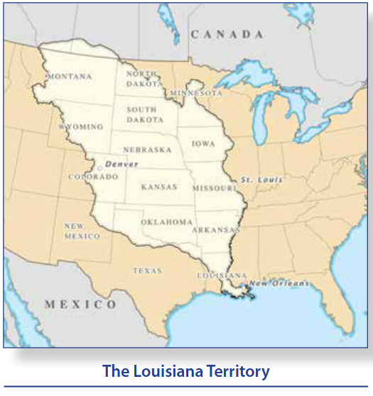
The Louisiana Purchase
France had lost its North American
possessions during the French
and Indian War.
Napoleon forced the Spanish to
give back the land they lost.
After the Haitian Revolution Napoleon
gave up on creating a French Empire
in North America and says the
land to the US.
The United States bought the
French territory for 15 Million $

Slide 14
Lewis & Clark Expedition

Slide 15
Lewis & Clark Expedition
Jefferson sent Meriwether Lewis and William Clark
to explore the new territory.
“corps of discovery” set of from St. Louis in 1804
reached the Pacific Ocean in November 1805
https://www.youtube.com/watch?v=vn7eqCq6LKI

Slide 16
Thomas Jefferson White House Biography
https://www.whitehouse.gov/about-the-white-house/presidents/thomas-jefferson/

Slide 17
EVALUATION!!

Slide 18
GEORGIA STANDARDS OF EXCELLENCE
SSUSH6: Analyze the challenges faced by the first five presidents and how they responded.

